Slide 1


Events in the Legal Domain
First Impressions
María Navas-Loro
Ontology Engineering Group (UPM)
Cristiana Santos
University of Toulouse
Universidade do Minho
Víctor Rodríguez-Doncel
Ontology Engineering Group (UPM)
mnavas@fi.upm.es
@mnavas314
14/02/2019
OEG

Slide 2
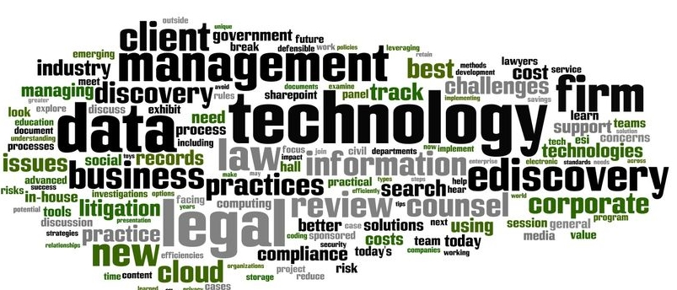
Outline
Outline
Research Questions
Toulouse
Conclusions
Future Steps
EXTENDED VERSION:
Our First Analysis
General observations
Lessons learned

Slide 3

RESEARCH Questions
Introduction

Slide 4
Research questions
Open questions:
What is an event in the legal domain?
What is a relevant event in the legal domain?
Within the same judgment/legislation/contractual clauses which are the most relevant events?
What is the relevant information about them?
How do we measure it?
How do we annotate and represent them?
How to extract them?
How do we evaluate?

Slide 5
1. What is an event in the legal domain?
Article 8
Duration of the subscription contract
The subscription contract is concluded for an indeterminate period with an initial period of one year. The duration of this initial period may however vary depending on the offer tariff chosen by the customer and included in the Orange tariff sheet
(Les Conditions Générales d’Abonnement à l’offre Orange)
Article 34
Communication of a personal data breach to the data subject
When the personal data breach is likely to result in a high risk to the rights and freedoms of natural persons, the controller shall communicate the personal data breach to the data subject without undue delay. (GDPR)
14- On 5 March 2010, Mr Costeja González, a Spanish national resident in Spain, lodged with the AEPD a complaint against La Vanguardia Ediciones SL, which publishes a daily newspaper with a large circulation, in particular in Catalonia (Spain) (‘La Vanguardia’), and against Google Spain and Google Inc. The complaint was based on the fact (…) (ECJ)

Slide 6
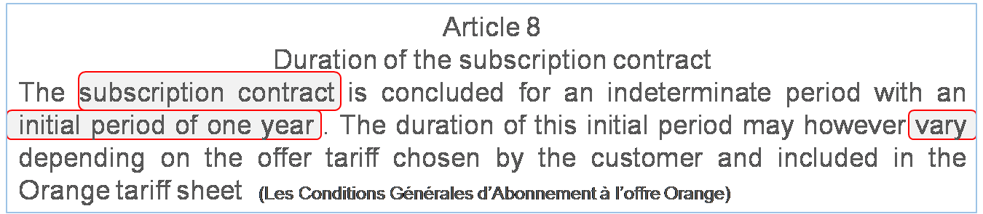
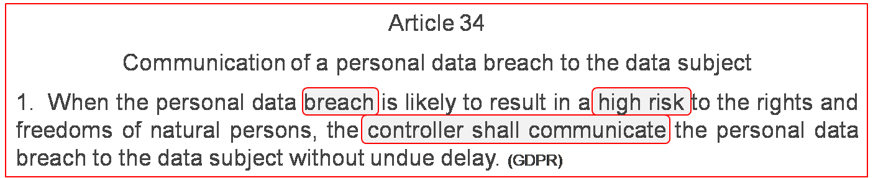
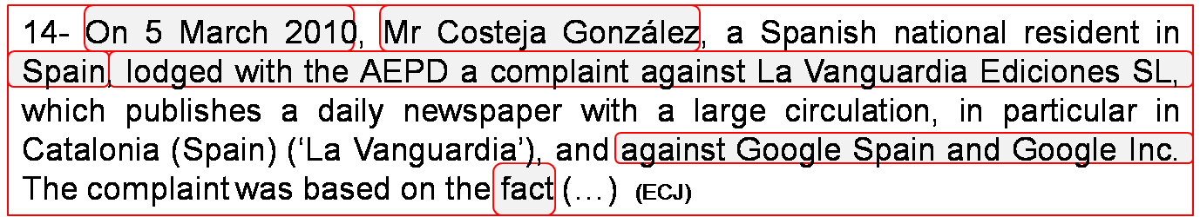
1. What is an event in the legal domain?

Slide 7
2. Which events are relevant?
Experiment idea:
Take a good state of the art temporal tagger
TARSQI: the tool developed by the team that created the TimeML standard (Pustejovsky & co)
Take a corpus on legal documents (ACQUIS)
Annotate!
70 docs (because it is so slow)
I just let it annotate (remotely, on Christmas)
2 days later, it was blocked. Not enough memory I guess.
Checked annotations.
Around 1500 events per doc!

Slide 8
2. What is relevant to an legal event?
Judgement
Time and Date
Claim
Interpretation
Domain
Argument
Facts of the case
What is a relevant
legal event?
Contract
Citations of case law
Jurisdiction
Judicial procedure
Parties/roles in a court dispute
Legal Definition

Slide 9
3. How do we measure this relevance?
Relevance is related to objective and to representation.
Previous efforts:
(Chasin, 2010) No metrics are provided:
They use a temporal tagger.
Asume the event is the tagged sentence.
They rank them with different measures (POS, gramatical, distance to Named Entities, length…). Also considered negation.
(Prasojo et al, 2018) No metrics on events:
Extract events.
Use them for summarization.
They evaluate the summary (sum. metrics + human assessment)

Slide 10
4. How can we annotate and represent them?
Several annotation schemas:
TimeML: focused on temporal information, types (reporting, aspectual, state…)
ACE: different types; among them, JUSTICE, with:
arrest-jail, release-parole, trial-hearing, sue, execute, appeal…
General ontologies:
Time + PROV
Event Ontology, by Yves Raymond
Simple Event Ontology
Ontology Design Patterns (description-situation, event processing)
Frames (like in FrameNet)
Most cases, each work has its own ad hoc definition.

Slide 11
5. How to extract them?
Depends on the event related definition/information:
Previous legal literature:
Semantic Role Labelling
Patterns verb + date
Semantic frames
Definition-oriented extraction of general events:
An event is:
any verb,
deverbal noun,
noun after during…

Slide 12
6. How do we evaluate this extraction?
We have several things to evaluate:
Event detection
Argument detection
Relevance
Previous proposals:
Precision, Recall and F-measure (TimeML – TempEval)
Question Answering (SemEval 2015)
ACE: VDR value (extent of the annotation, arguments, attributes)
Other ideas:
Several levels of evaluation (BioNLP’09)
Core
Core + surrounding entities
Core + surrounding entities + factuality

Slide 13
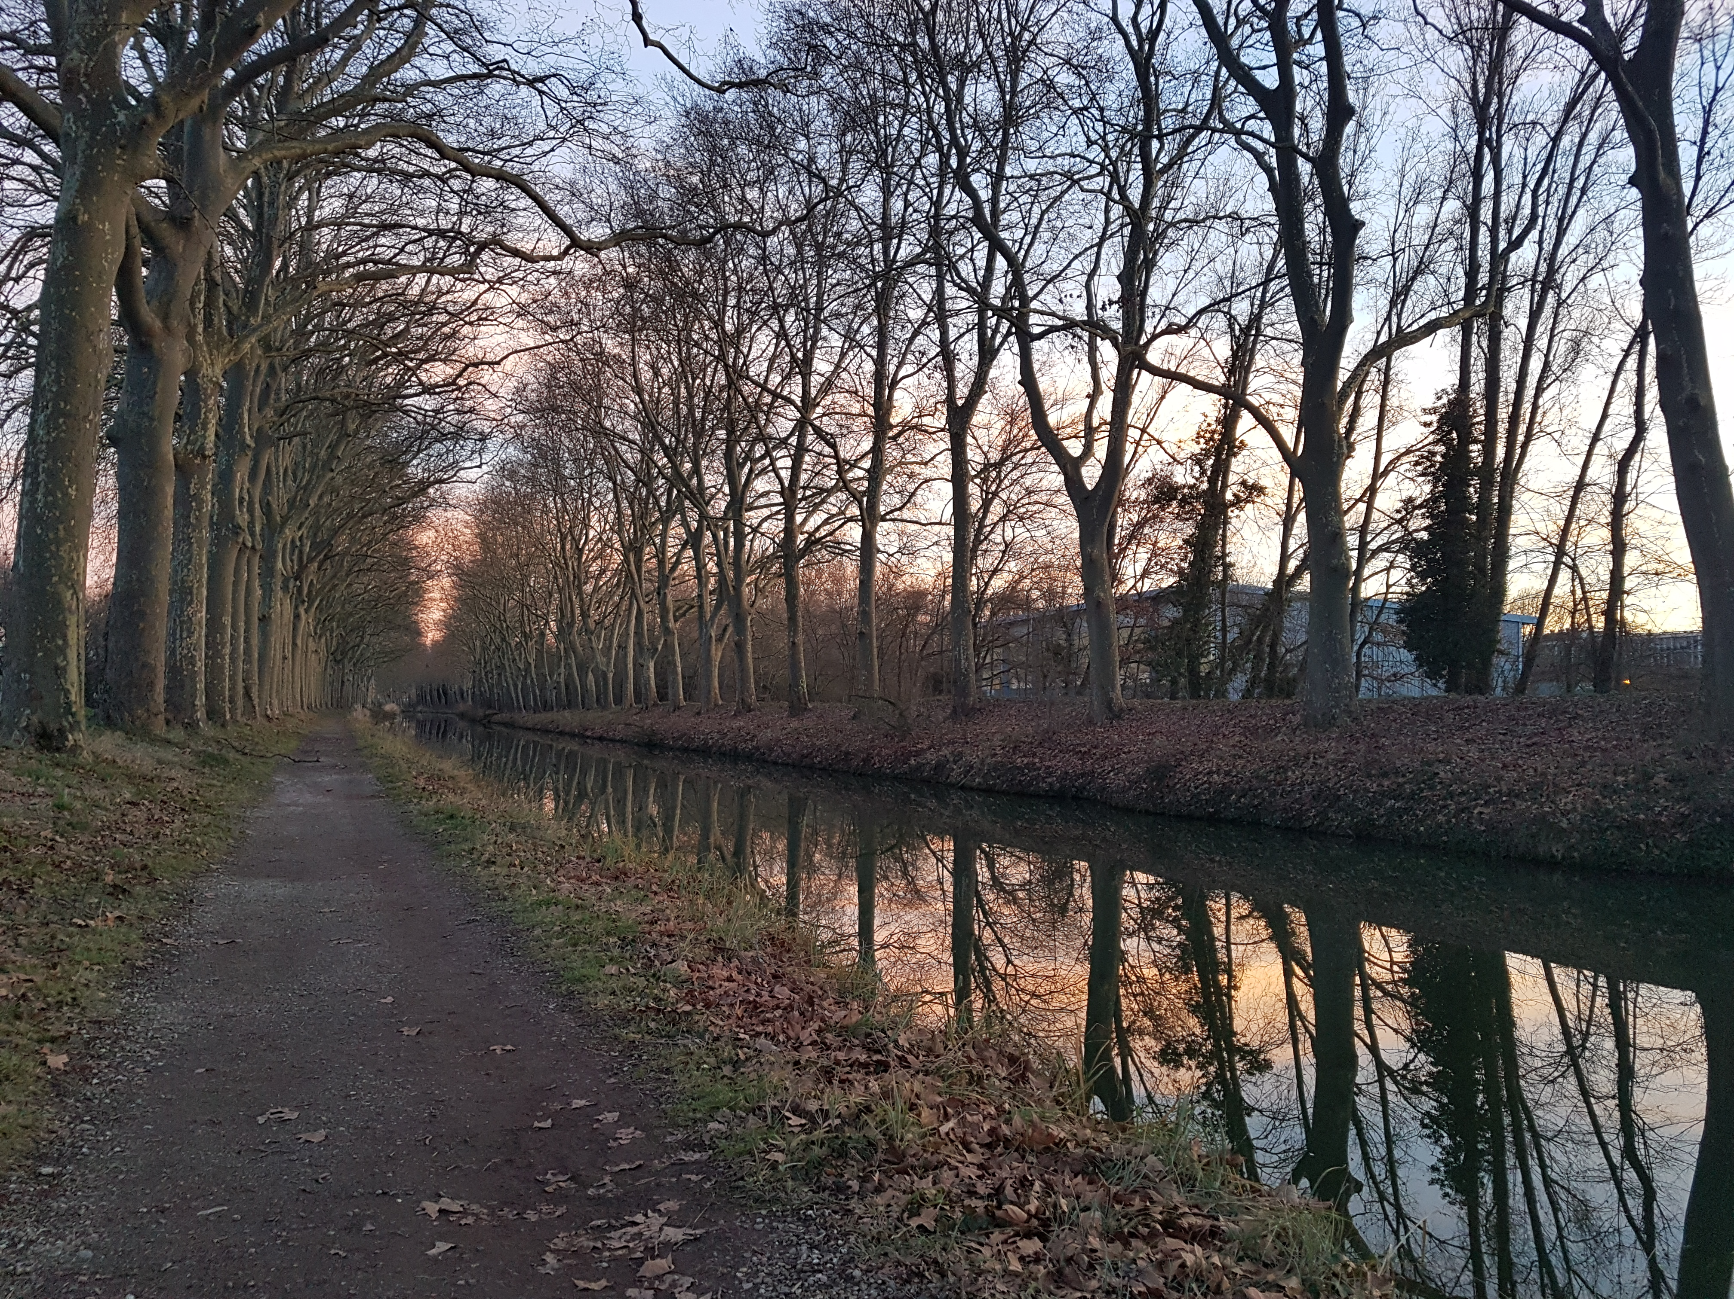
TOULOUSE
Visit

Slide 14
Objectives
Idea:
Extract and represent judgments in an event-centric way.
Useful for: summarization, timelines, Information Extraction…
Background:
We had been in discussion for 3/6 months.
First rounds of annotation and discussion.
We analyzed previous representation options (general and legal)
We presented the idea in a workshop and to people in the domain, good feeling (just one excepcion)
Target:
We had several ideas, we had to focus on specific contributions.
We had to start new round of annotations.
We had to decide the annotation schema.
We had to choose/develop a data model (ontology?)

Slide 15
Objectives
Ideas to focus on:
Data model for legal events.
Corpus to support the usefulness and feasability of this data model.
Concept of relevance and how to measure it.
Event extractor to be tested in this corpus.
For this paper, just focusing on the first three
We stablished a planing with different deadlines, until June.
(so any ideas/references/similar works in other domains are welcome!)

Slide 16
Objectives
Annotation schema:
Waiting for the first 10 docs annotated to decide common patterns, but clear overlappings among events / judgments.
Already discussing with some experts in the domain.
Plan to do a table to decide / justify:
REQ / PROPOSALS | When | What | Before Court | …
Onto [1]
Ann. Sch [2]
…
Akoma Ntoso [13]
LKIF [42]
…
GENERAL
LEGAL

Slide 17
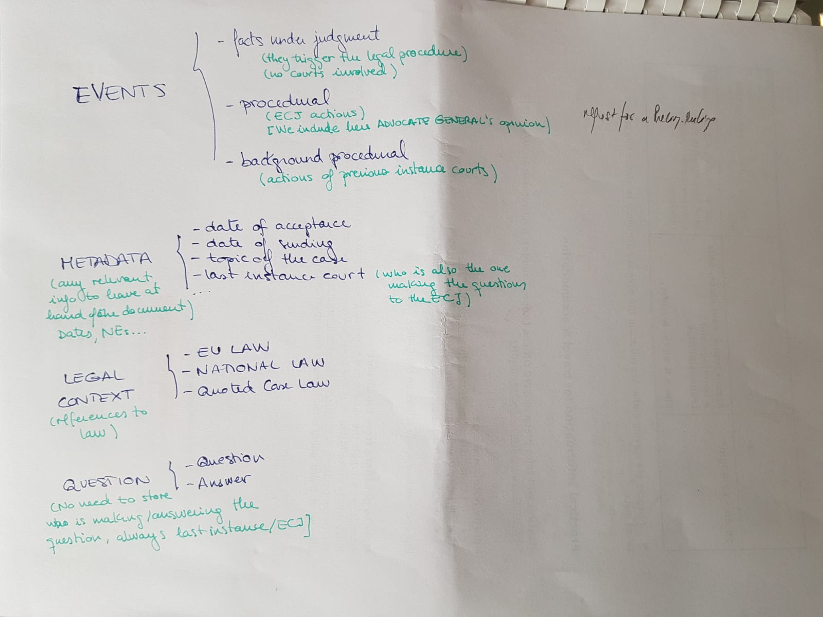
Objectives
Annotation schema. What we have for now (+ arguments of each event)

Slide 18
Objectives
Annotation:
She was not familiar to any format (before, she worked in word documents, just highlighting).
The idea was using BRAT, but not operative ☺
I tried to introduce JSON.
We tried to use Excel. Almost there.
Solution: template! (advice: tricky langague handling…)
Still, problems with debugging the columns.
Solution: (basic) visualization (visjs, better options?)
Evaluation: interannotation (voluntieers? :D)
Solution: Double annotation within 2 weeks (do you know about this?)

Slide 19

Conclusions
Future work

Slide 20
Conclusions
Work done:
Overview of previous definitions and approaches.
Analysis of representation options:
Several (Akoma Ntoso, LKIF…), no standard or consensual definition/representation for legal event available.
First annotation lead to first ideas for definition and extraction.
Identification of possible applications: Case-based reasoning, Legal Argumentation, Contract Review…
Future work
Atomizing properties, instances and atributes of legal events. Construction of a semantic model.
Assessment criteria for validating relevance of legal events.
Event extractor in the legal domain.

Slide 21

THANK YOU FOR TOUR ATTENTION, now
(please)

Slide 22
Events in the Legal Domain
First Impressions
María Navas-Loro
Ontology Engineering Group (UPM)
Cristiana Santos
University of Toulouse
Universidade do Minho
Víctor Rodríguez-Doncel
Ontology Engineering Group (UPM)
mnavas@fi.upm.es
@mnavas314
14/02/2019
OEG

Slide 23

General Observations
Our First Analysis

Slide 24
General Observations
Legal events vary according to different criteria:
Multy-jurisdictionality and multilingualism:
eg, in Japan there exist the concept of rescinding a rescision of a contract, but it does not in Europe.
eg, some types of laboral contracts do not exist in all countries.
Document dependency:
Type: contracts/case law/regulations…
Domain (criminal, taxes…), specially for relevance.
Level of abstraction:
Same event can be of different types depending on the considered abstraction.
eg, “observation” can be a reporting event (the court observes), a procedural event (written observations).

Slide 25
General Observations
Agents and role:
The consideration of an event can vary according to the agent reporting it.
eg, the victim’s view vs the perpetrator’s.
Temporal, contextual and spatial features:
Different events in the same proceedings can be held in different contexts/time/space axis
Eg, submission of an application by an applicant in their National Court, pleadings, appeal to another court, ruling by the ECJ…
Scenario or application-based:
Depending the objective of the work, the definition and the relevance of events vary.

Slide 26

Lessons learned from our use case
Our First Analysis

Slide 27
Lessons learned – Corpus and annotation
10 document corpus (4820 words/doc) from the European Court of Justice.
Analysis of common structure, sections with relevant events:
Preamble
Background of the case
Considerations
Final ruling
First annotation comprehends:
Contextual relevant information (by a lawer)
The event
Related synonyms

Slide 28
Lessons learned - Observations
Coverage:
Linguistic: nouns, verbs, nominal phrases.
Difficult to set boundries for roles and actors.
Legal terminology:
Always tricky (polysemy, vagueness, ambiguity, synonymy), plus:
Change of meaning of conventional terms:
Against the applicant.
Before the Court.
Terms with several interpretations, such as submit:
Express an argument.
“Submit written observations”, procedural documents lodged before the Court.

Slide 29
Lessons learned - Observations
Info in the preamble:
Identity-related events: the referring court, litigant parties (applicant/defendant), agents (States, European Commission…)
Location- and date-related events: eg “10 September 2014, Request for a preliminary ruling from the Krajsky Sud v Presove (Slovakia)”
Domain-related: indicated in the initial summary (eg, illegal migration)
Background of the case:
The most interesting and includes the most relevant events, arguments and facts.
Events subsumed to national courts:
Expressions including mentions to “National Court”, “Regional Court”, “Disctrict Court” and similar.

Slide 30
Lessons learned - Observations
Interpretative issues:
Different versions from each of the parts on the same event.
Negation and factuality:
Events can be negated, or “possibilities, intentions or preferences”:
eg, “The Court does not have before it any evidence which might raise doubts as to the compliance of the legislation at issue in the main proceedings with that principle''; (...) ``In the light of the answer to the first three questions, it is not necessary to respond to that request by the Slovak Government.”
Legal related events location:
They can be at different structures of documents (paragraph, summary, conclusion...)

Slide 31
Lessons learned - Observations
Descriptors found:
Some expressions are indicative of events:
Concerning identification events:
Petition type (eg preliminary ruling)
Composition of the court
Date of the judgment
Parties involved
Topical content of the case
Facts
Quoted case-law: courts attempt to ground the decision by reference to past case-law.
Judgment delivery.

